Slide 1

Inductive Logic Programming for Heuristic Search
Rojina Panta, Vedant Khandelwal,
Celeste Veronese, Amit Sheth,
Daniele Meli, and Forest Agostinelli
Presenter:
Rojina Panta
rpanta@email.sc.edu
12th September, 2025

Slide 2
OUTLINE
Background
Motivation
Problem Statement
Mapping states to numbers
Learning Logic Program Heuristics for Supervised Dataset
Generating Dataset
Learning Logic Program Heuristics for Supervised Datasets with Predicate Reuse
Logic Program Heuristics With Dynamic Programming Search
Generating Dataset with A* Search
Learning Heuristics Without Predicate Reuse
Learning Heuristics With Predicate Reuse
Performance Evaluation
Explainability
Takehome

Slide 3
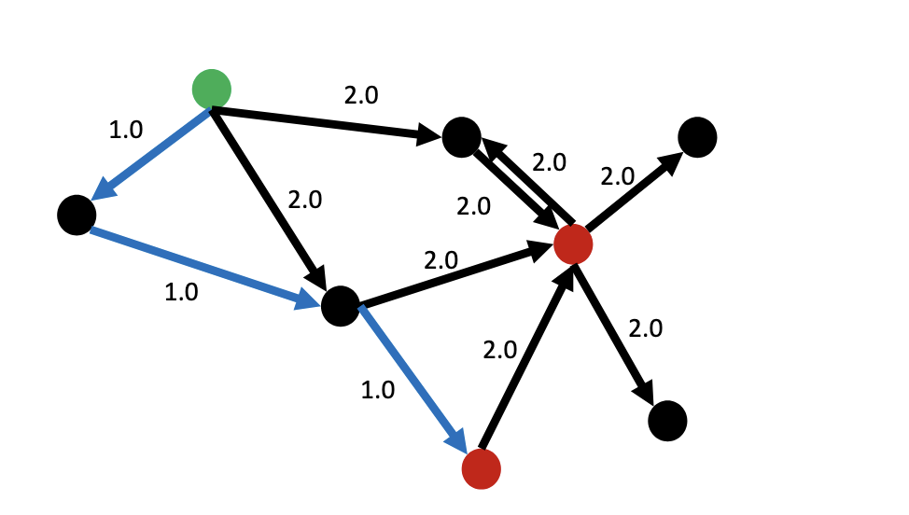
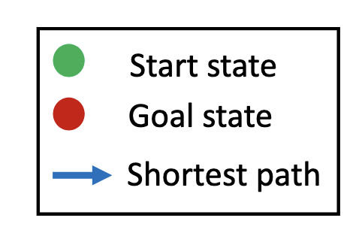
PATHFINDING
The objective of pathfinding is to find a sequence of actions that forms a path between a given start state and a given goal.
A goal is a set of states.
Preference for minimum cost paths.
A pathfinding problem can be represented as a weighted directed graph where nodes represent states, edges represent actions that transition between states, and edge weights represent transition costs.
The cost of a path is the sum of transition costs.
https://cse.sc.edu/~foresta/assets/files/SoCSMasterClass.pdf

Slide 4
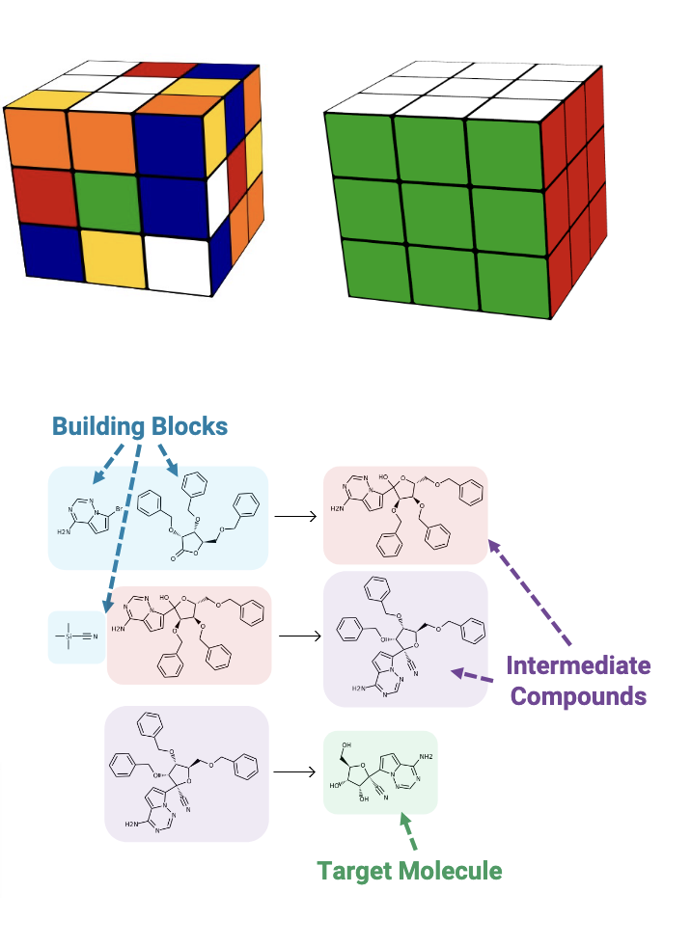
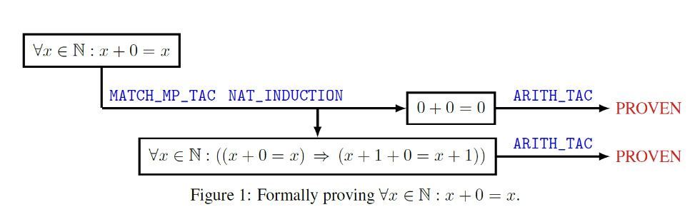
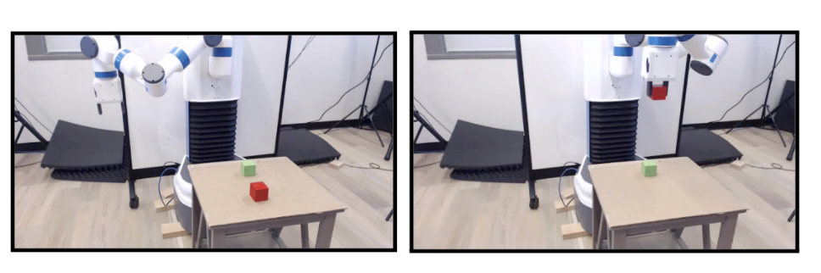
PATHFINDING DOMAINS
Pathfinding problems can be found throughout mathematics, computing, and the natural sciences.
Puzzle solving, chemical synthesis, theorem proving, robotics.
https://cse.sc.edu/~foresta/assets/files/SoCSMasterClass.pdf

Slide 5
INTRODUCTION
One of the most effective ways to solve the pathfinding problem is heuristic search.
Heuristic search is a process of finding the sequences of actions that go from the start state to the goal state
Is guided by a heuristic function.
In the search tree, nodes are states and edges are actions
The key element for heuristic search is the heuristic function.
Heuristic function:
Estimates the distance between the state and the goal.
How close you are to solving a problem.
The heuristic function can be manually curated, but building a domain-specific heuristic function might take months and years of research.

Slide 6
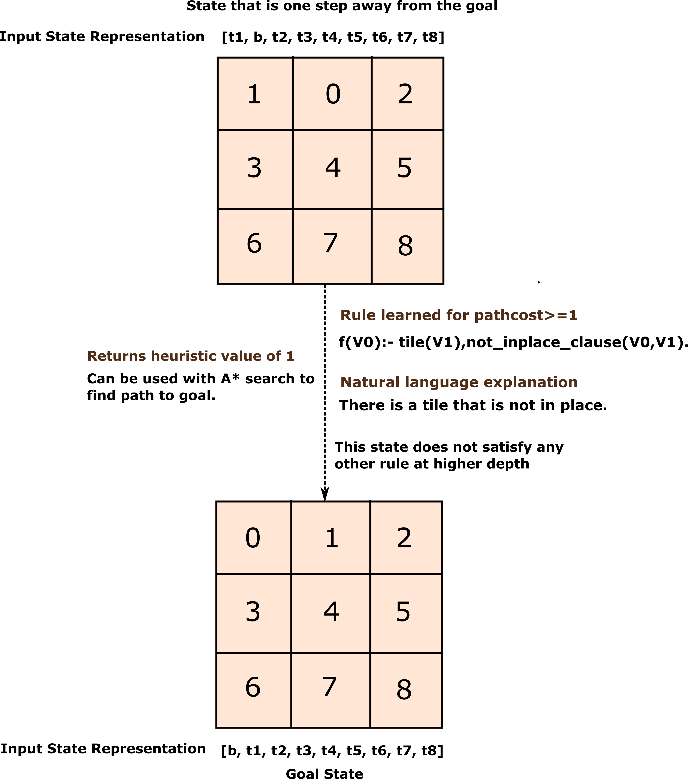
MOTIVATION
Start State
We can also learn strong heuristic functions with methods like Deep Reinforcement Learning (DRL), but neural networks are black boxes and hard to interpret.
Logic programs are somewhat explainable, yet methods to learn heuristic functions represented as logic programs are missing.
We present an algorithm to learn heuristic functions represented as logic programs using Dynamic Programming and Inductive Logic Programming (ILP).

Slide 7
MOTIVATION
Start State
We can also learn strong heuristic functions with methods like Deep Reinforcement Learning (DRL), but neural networks are black boxes and hard to interpret.
Logic programs are somewhat explainable, yet methods to learn heuristic functions represented as logic programs are missing.
We present an algorithm to learn heuristic functions represented as logic programs using Dynamic Programming and Inductive Logic Programming (ILP).

Slide 8
PROBLEM STATEMENT
Deep Neural Network (DNN) can directly map states to numbers, i.e., states to cost-to-go (ctg).
Modern ILP systems, such as Popper, do classification.
That classifies between positive and negative examples.
How can we use this to do regression instead?
Classification to regression.
Let us start with the dataset where we have all the true cost-to-gos.
How will we use ILP to approximate true cost-to-go from some dataset?
Cropper, Andrew, and Rolf Morel. "Learning programs by learning from failures." Machine Learning 110.4 (2021): 801-856.

Slide 9
OUTLINE
Background
Motivation
Problem Statement
Mapping states to numbers
Learning Logic Program Heuristics for Supervised Dataset
Generating Dataset
Learning Logic Program Heuristics for Supervised Datasets with Predicate Reuse
Logic Program Heuristics With Dynamic Programming Search
Generating Dataset with A* Search
Learning Heuristics Without Predicate Reuse
Learning Heuristics With Predicate Reuse
Performance Evaluation
Explainability
Takehome

Slide 10
Mapping States TO Numbers
Let us assume we have our heuristic dictionary with logic program rules.
How can we map our states into number provided this heuristic?
In this work, we assume that all transition costs are 1.
So, we know our true cost-to-go will be an integer.
Here is what our heuristic dictionary will look like.
{1: [rule1], 2: [rule2 ,rule3, rule4], 3:[rule5, rule6], 4: [rule7, rule 8, rule9], ……. }
Key to the dictionary represents cost-to-go.
If the key is 1, then it means that if any of our states are satisfied with these rules, the cost-to-go of states from the goal is at least 1.
Our rule in predicate format can look like {1: [‘f(V0):- tile(V1), not_inplace_clause(V0,V1)’]}

Slide 11
Mapping States TO Numbers
Heuristic Dictionary:
{1: [rule1],
2: [rule2 ,rule3, rule4],
3: [rule5, rule6],
4: [rule7, rule 8, rule9], ……. }
First, check our state with rules at cost-to-go>=1 and see whether it satisfies rule 1.
If it does not satisfy rule 1, we stop and return 0 as our cost-to-go since every state is at least zero steps away from the goal.
If it satisfies rule 1, we then check if the state satisfies the rule at cost-to-go >=2. We check whether it satisfies one of the rules (rule 2, rule 3, rule 4) at cost-to-go>= 2.
If it does, the cost-to-go of the state is at least 2.
If not, then we return the cost-to-go of the state as 1.

Slide 12
Mapping States TO Numbers
Heuristic Dictionary:
{1: [rule1],
2: [rule2 ,rule3, rule4],
3: [rule5, rule6],
4: [rule7, rule 8, rule9], ……. }
Similarly, the process repeats for higher cost-to-go until there are no rules at higher cost-to-go that satisfies the state.
In our case, we use binary search to traverse the cost-to-go.
There are also some costs for which we do not learn any rule; we skip these costs-to-go while mapping states to cost-to-go.
We saw a mechanism to map the states to cost-to-go.
Now we will look into how we can construct the heuristic required for this architecture.

Slide 13
OUTLINE
Background
Motivation
Problem Statement
Mapping states to numbers
Learning Logic Program Heuristics for Supervised Dataset
Generating Dataset
Learning Logic Program Heuristics for Supervised Datasets with Predicate Reuse
Logic Program Heuristics With Dynamic Programming Search
Generating Dataset with A* Search
Learning Heuristics Without Predicate Reuse
Learning Heuristics With Predicate Reuse
Performance Evaluation
Explainability
Takehome

Slide 14
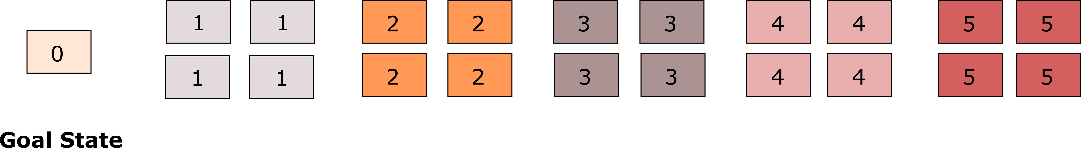
APPROACH: LOGIC PROGRAM HEURISTICS FOR SUPERVISED DATASET
Let us imagine we have a supervised dataset for the 8-puzzle domain where we already have a mapping of states to cost-to-go.
We need a method to train with this dataset to learn a heuristic function.
The numbers inside the boxes are true cost-to-go’s, so this is our labelled dataset.
Each box is a state.

Slide 15
Learning Logic Program Heuristics
We first start with an empty heuristic dictionary.
We represent the state with cost-to-go 0 as a negative example and everything else as a positive example, and pass it to the ILP system Popper.
ctg>=1
Positive Examples
Negative Example
Heuristics Dictionary: {}

Slide 16
Learning Logic Program Heuristics
Then we update our heuristic function with the rule learned for cost-to-go>=1.
We then represent state with cost-to-go 0 and 1 as negative example and everything else as positive.
We use updated states to learn the rules for cost-to-go>=2.
Negative Examples
ctg>=2
Positive Examples
Heuristics Dictionary: {1: [‘f(V0):- Pred1(V1), Pred2(V0,V1)’]}

Slide 17
Learning Logic Program Heuristics
Negative Examples
ctg>=3
Positive Examples
Heuristics Dictionary: {1: [‘f(V0):- Pred1(V1), Pred2(V0,V1)’]
2: [‘f(V0):- Pred1(V2),Pred3(V2,V3),Pred4(V0,V3), Pred6(V3,V4),Pred2(V1), Pred9(V4,V1)’]}
Negative Examples
ctg>=4
Positive Examples
Heuristics Dictionary: {1: [‘f(V0):- Pred1(V1), Pred2(V0,V1)’],
2: [‘f(V0):- Pred1(V2),Pred3(V2,V3),Pred4(V0,V3), Pred6(V3,V4),Pred2(V1), Pred9(V4,V1)’],
3: [‘f(V0):- Pred8(V1),Pred3(V0,V1)’, ‘f(V0):- Pred8(V1), Pred4(V0),Pred3(V0,V1)’]}

Slide 18
OUTLINE
Background
Motivation
Problem Statement
Mapping states to numbers
Learning Logic Program Heuristics for Supervised Dataset
Generating Dataset
Learning Logic Program Heuristics for Supervised Datasets with Predicate Reuse
Logic Program Heuristics With Dynamic Programming Search
Generating Dataset with A* Search
Learning Heuristics Without Predicate Reuse
Learning Heuristics With Predicate Reuse
Performance Evaluation
Explainability
Takehome

Slide 19
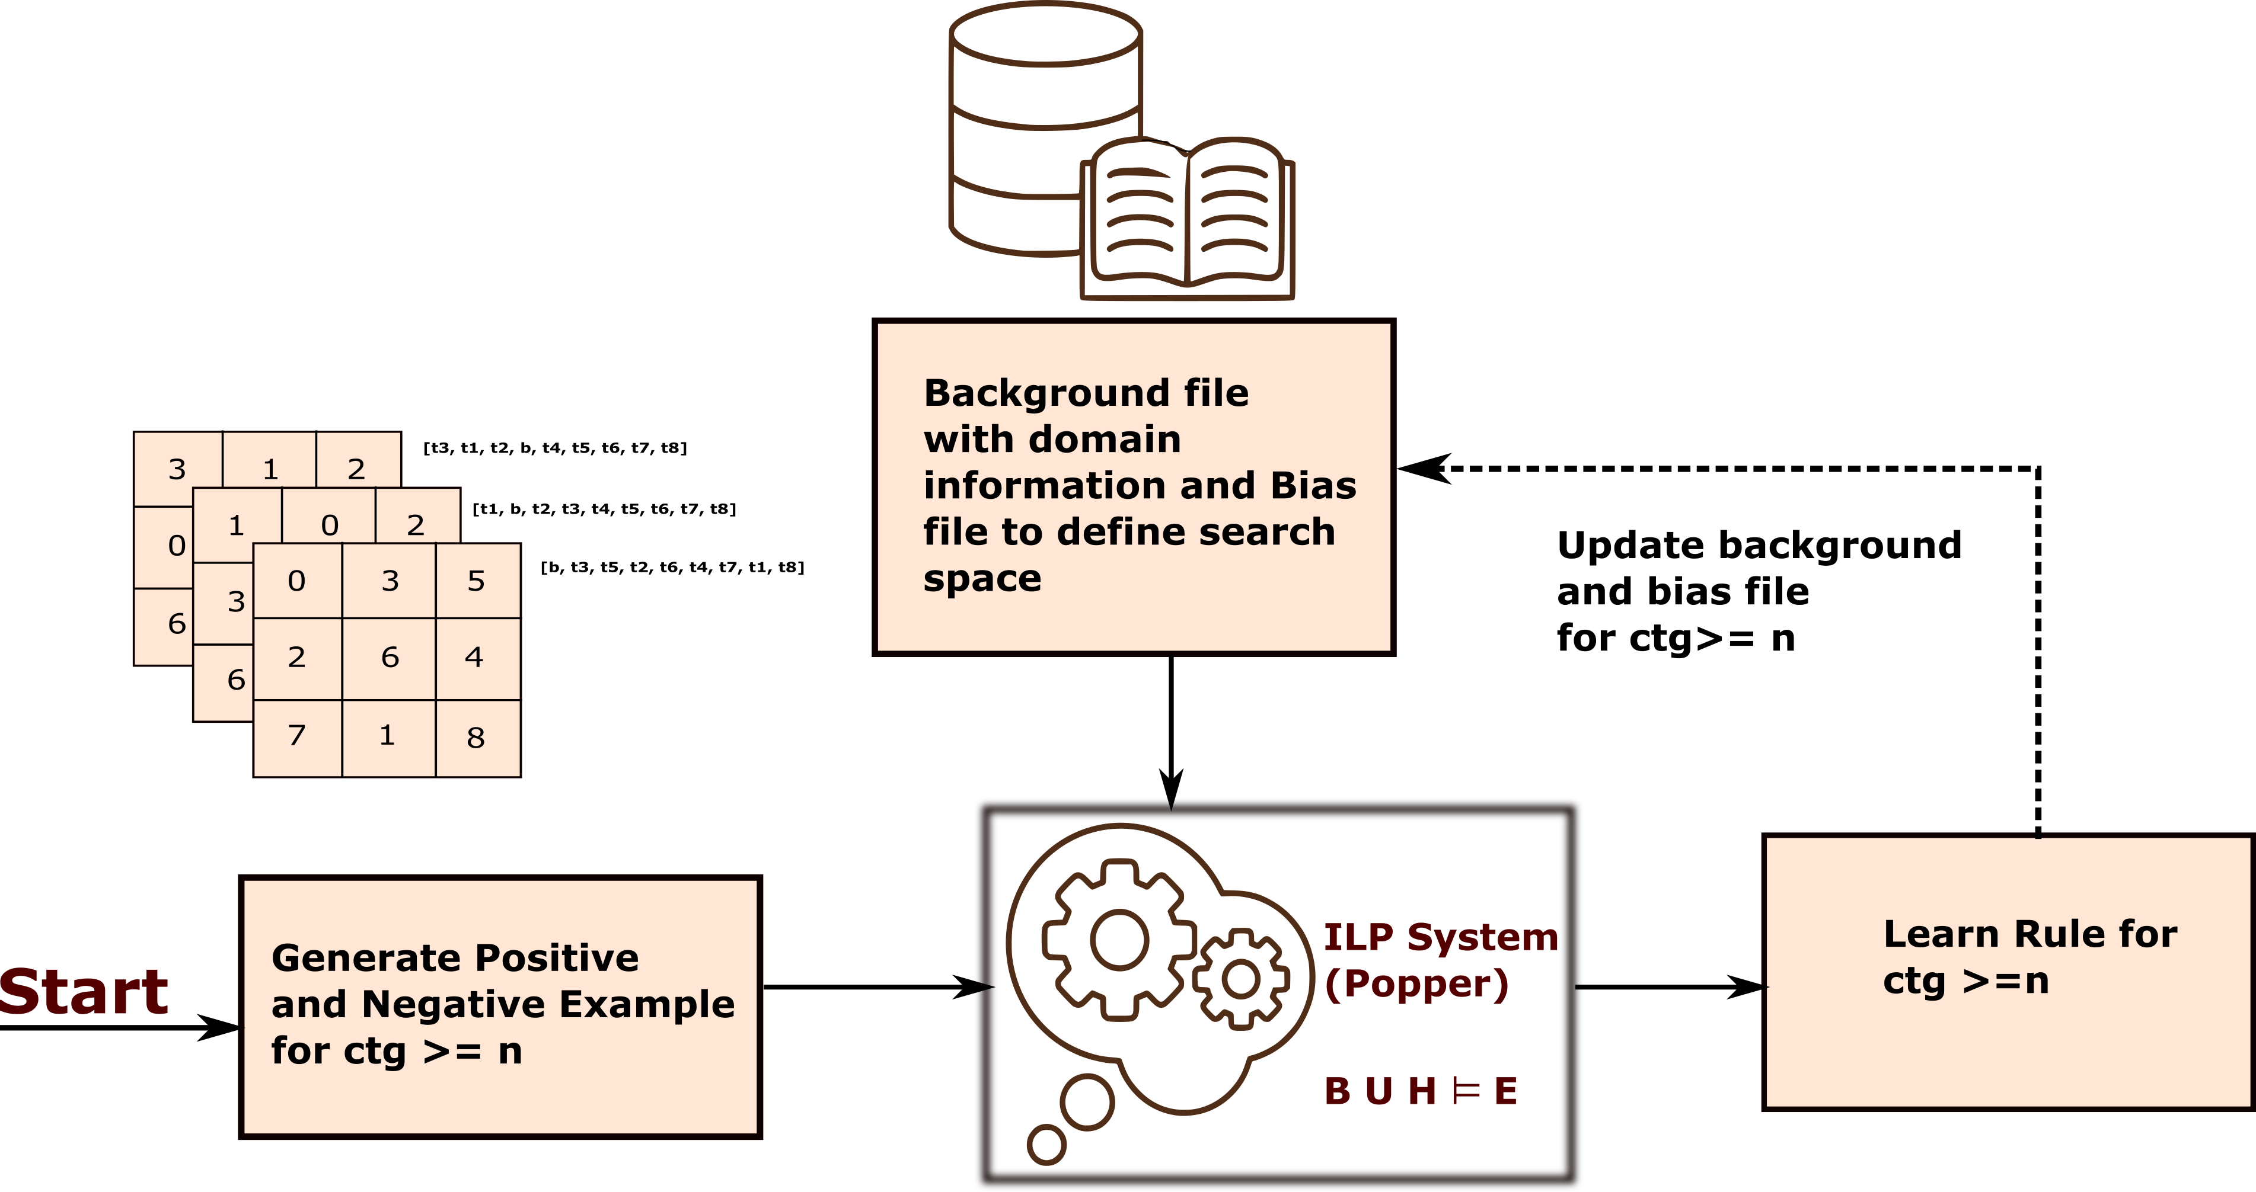
APPROACH: LEARNING HEURISTICS WITH PREDICATE REUSE
We can build on the given background knowledge by allowing predicates learned from a lower cost-to-go value to be used to learn logic programs for a higher cost-to-go value.
We reuse each clause learned for the logic program's previous target cost-to-go by renaming each clause and adding it to the background knowledge and hypothesis space.
This process builds on the dynamic programming concept of solving problems by reusing solutions to subproblems.

Slide 20
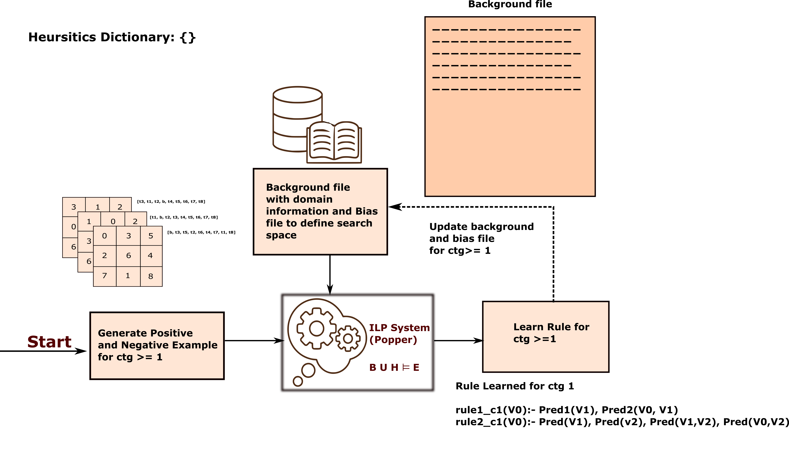
APPROACH: LEARNING HEURISTICS WITH PREDICATE REUSE

Slide 21
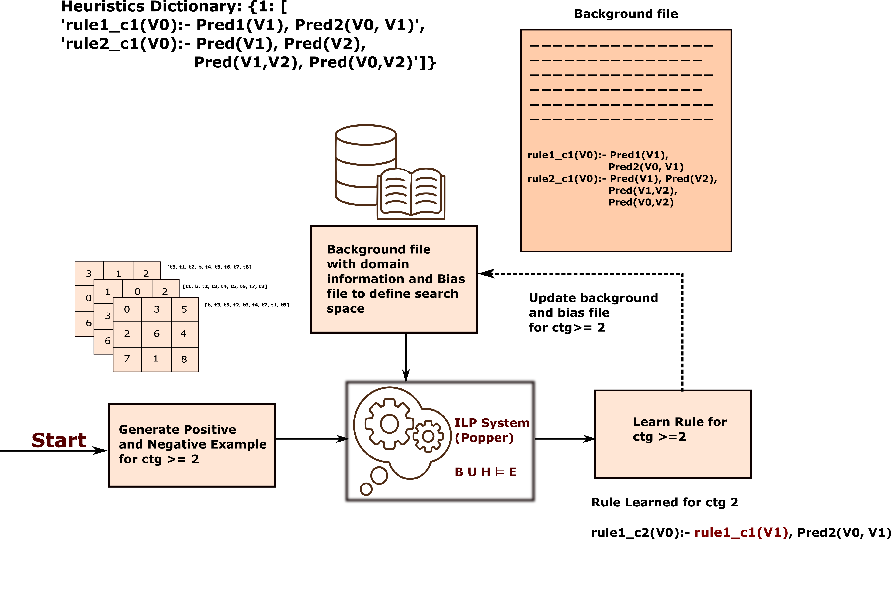
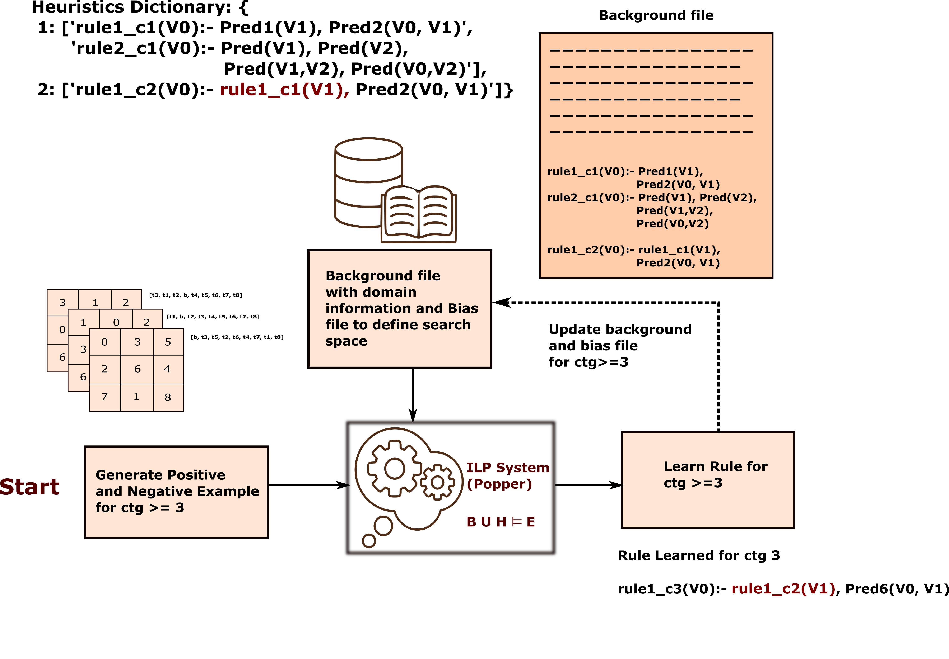
APPROACH: LEARNING HEURISTICS WITH PREDICATE REUSE

Slide 22
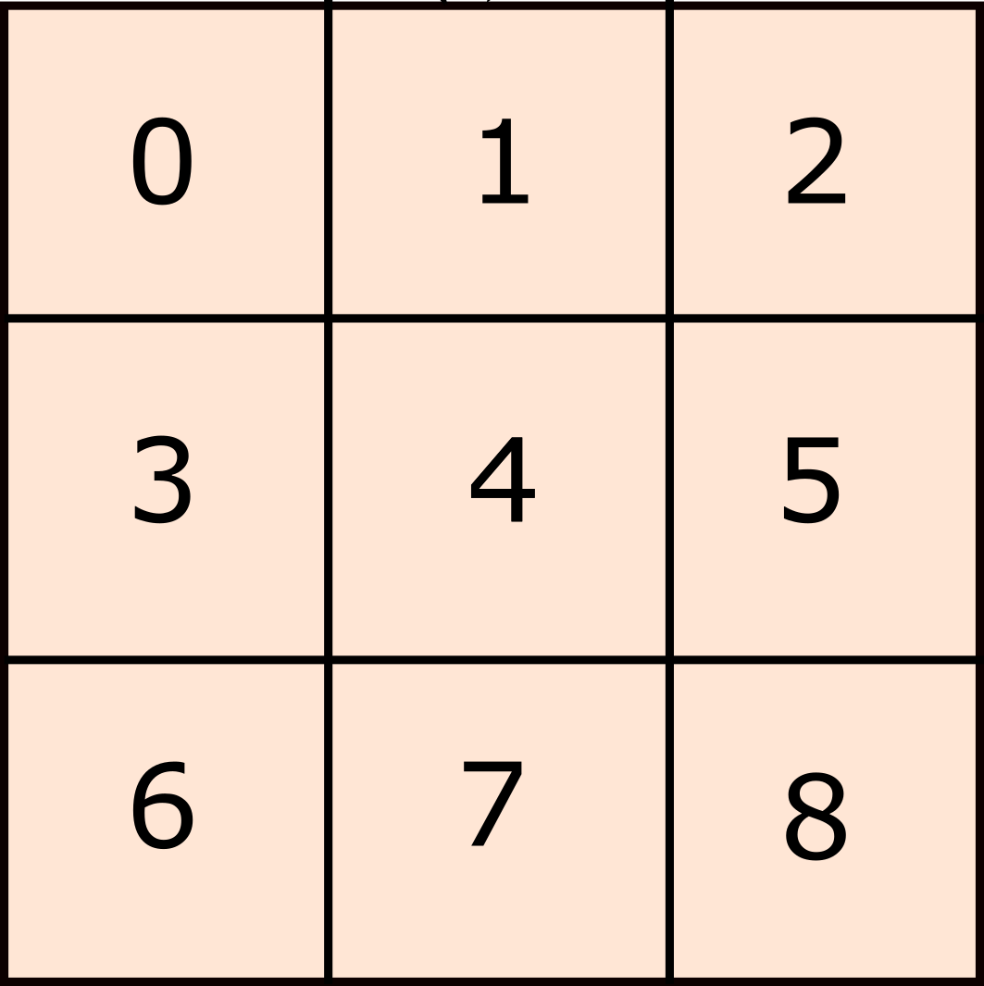
APPROACH: Logic Program Heuristics
This allows us to map a state to a number using a series of classifications.
--------------- ctg>=1 ---------------
f(V0):- tile(V1),not_inplace_clause(V0,V1).
--------------- ctg>= 2 ---------------
f(V0):- tile(V2),after_tile(V2,V3),not_inplace_clause(V0,V3),goal_index(V3,V4),indx4(V1),
distinct_indices(V4,V1).
--------------- ctg>= 3 ---------------
f(V0):- f(V0):- tile8(V1),not_inplace_clause(V0,V1).
f(V0):- tile7(V1),not_inplace_clause(V0,V1).
f(V0):- tile5(V1),not_inplace_clause(V0,V1).
f(V0):- tile6(V1),row2_comp(V0),not_inplace_clause(V0,V1).
f(V0):- col2_comp(V0),tile2(V1),not_inplace_clause(V0,V1).
f(V0):- tile(V2),after_tile(V2,V1),not_inplace_clause(V0,V2),after_tile(V1,V3),not_inplace_clause(V0,V3).
[b, t1, t2, t3, t4, t5, t6, t7, t8]
Goal State

Slide 23
OUTLINE
Background
Motivation
Problem Statement
Mapping states to numbers
Learning Logic Program Heuristics for Supervised Dataset
Generating Dataset
Learning Logic Program Heuristics for Supervised Datasets with Predicate Reuse
Logic Program Heuristics With Dynamic Programming Search
Generating Dataset with A* Search
Learning Heuristics Without Predicate Reuse
Learning Heuristics With Predicate Reuse
Performance Evaluation
Explainability
Takehome

Slide 24
APPROACH: LOGIC PROGRAM HEURISTICS WITH DYNAMIC PROGRAMMING SEARCH
However, what if we do not have a labelled dataset?
No cost-to-go information
We need a procedure to generate dataset and their cost-to-go information.
We use A* search for the same.
We use an updated heuristic at each step with A* search to get the path cost of the dataset.
So, we call this procedure dynamic programming search.

Slide 25
GENERATING DATASET WITH A* SEARCH
Initially, we do not know the cost-to-go values of any states.
We can use a type of a heuristic search algorithm, A* search, along with a heuristic function, to get the path cost of these states.
Initially, this heuristic function returns zero for all the states.
The heuristic search is not going to be successful all the time.
There are cases when we do not find a path within the allocated amount of time.

Slide 26
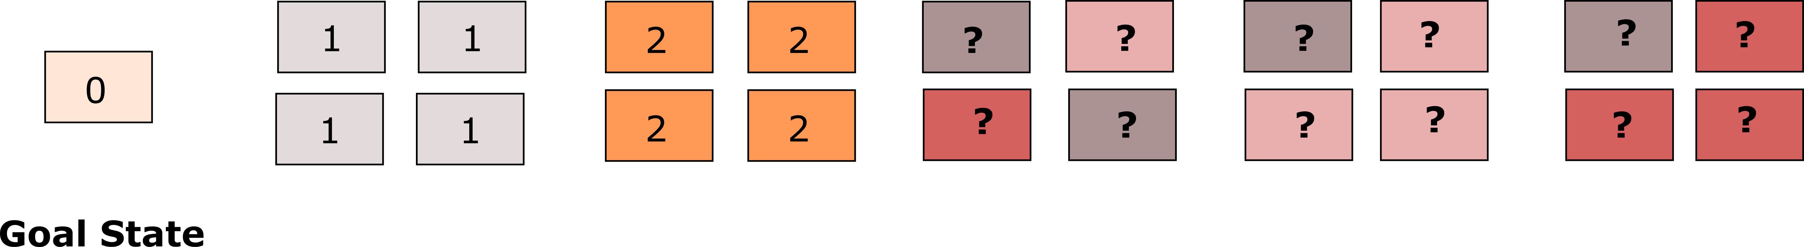
GENERATING DATASET WITH A* SEARCH
A* runs for 1000 iterations with a maximum time limit of 4 hours.
We first get the states with different path costs, classify states with path cost 0 as a negative example and all other states as positive, and pass this information to the ILP system Popper.
ctg>=1
Positive Examples
Negative Example
Heuristics Dictionary: {}

Slide 27
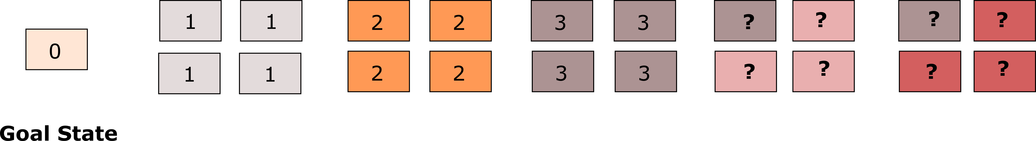
GENERATING DATASET WITH A* SEARCH
Then we update our heuristic function with the rule learned for cost-to-go>=1.
We use the updated heuristic function to generate dataset at cost-to-go>=2.
Since this updated heuristic function is more informative, it can now solve states with higher path costs within the same time limits.
We classify states with path costs 0 and 1 as negative examples and all others as positive examples and pass it to the ILP system Popper.
ctg>=2
Positive Examples
Negative Examples
Heuristics Dictionary: {1: [‘f(V0):- tile(V1),not_inplace_clause(V0,V1)’]}

Slide 28
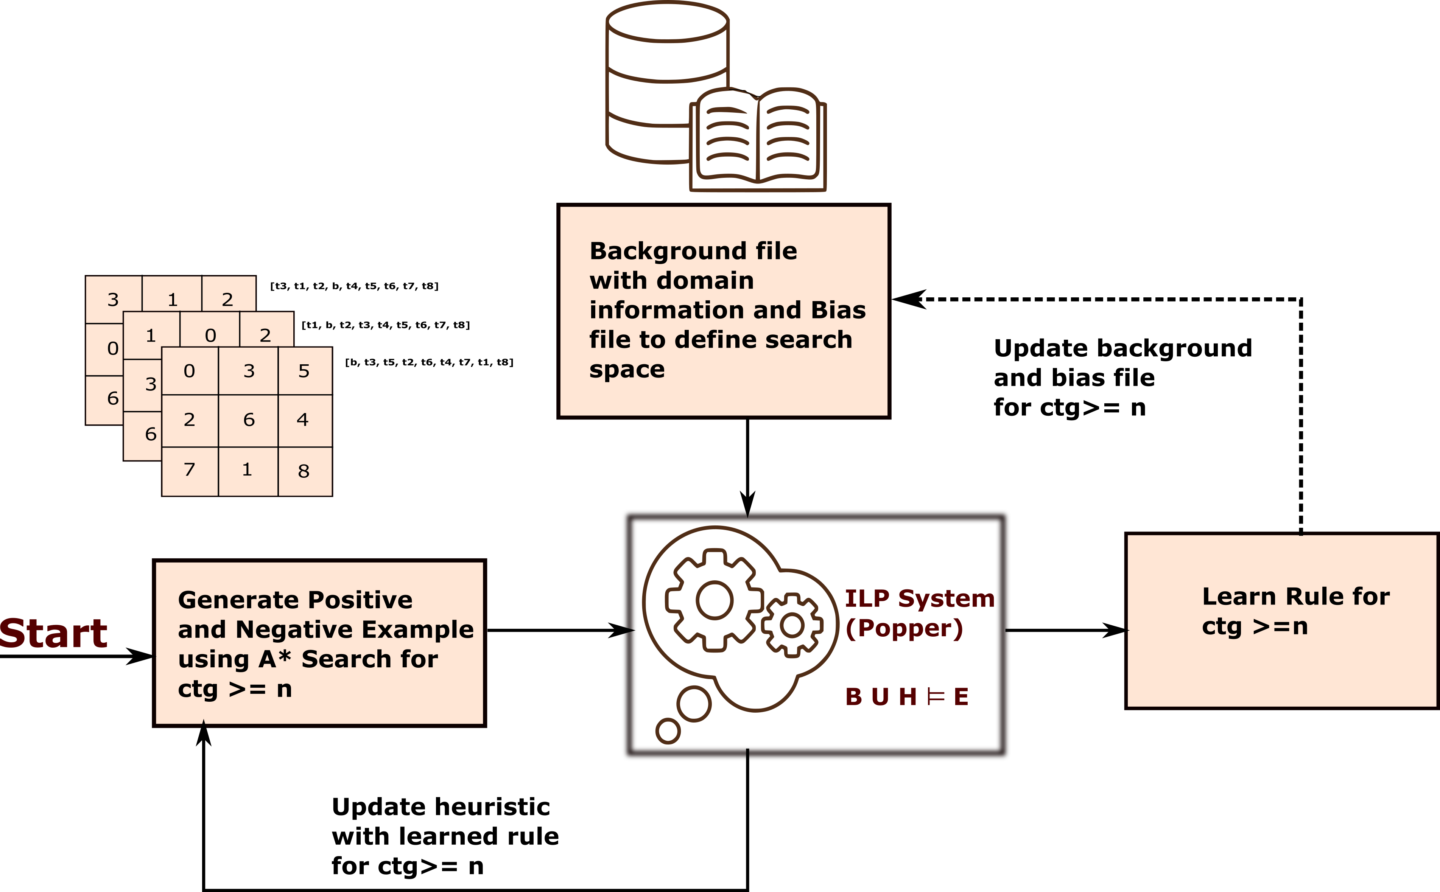
APPROACH: LEARNING HEURISTICS WITH A* SEARCH
We can learn heuristics in the same way we learned heuristics for supervised learning.
Only difference is that the supervised learning approach does not use updated heuristics, as in the case of A* search.

Slide 29
APPROACH: LEARNING HEURISTICS WITH A* SEARCH AND PREDICATE REUSE
Add rules learned for smaller cost-to-go values as background knowledge when learning for larger values.
This enables a dynamic programming style buildup from simple to complex heuristics.

Slide 30
OUTLINE
Background
Motivation
Problem Statement
Mapping states to numbers
Learning Logic Program Heuristics for Supervised Dataset
Generating Dataset
Learning Logic Program Heuristics for Supervised Datasets with Predicate Reuse
Logic Program Heuristics With Dynamic Programming Search
Generating Dataset with A* Search
Learning Heuristics Without Predicate Reuse
Learning Heuristics With Predicate Reuse
Performance Evaluation
Explainability
Takehome

Slide 31
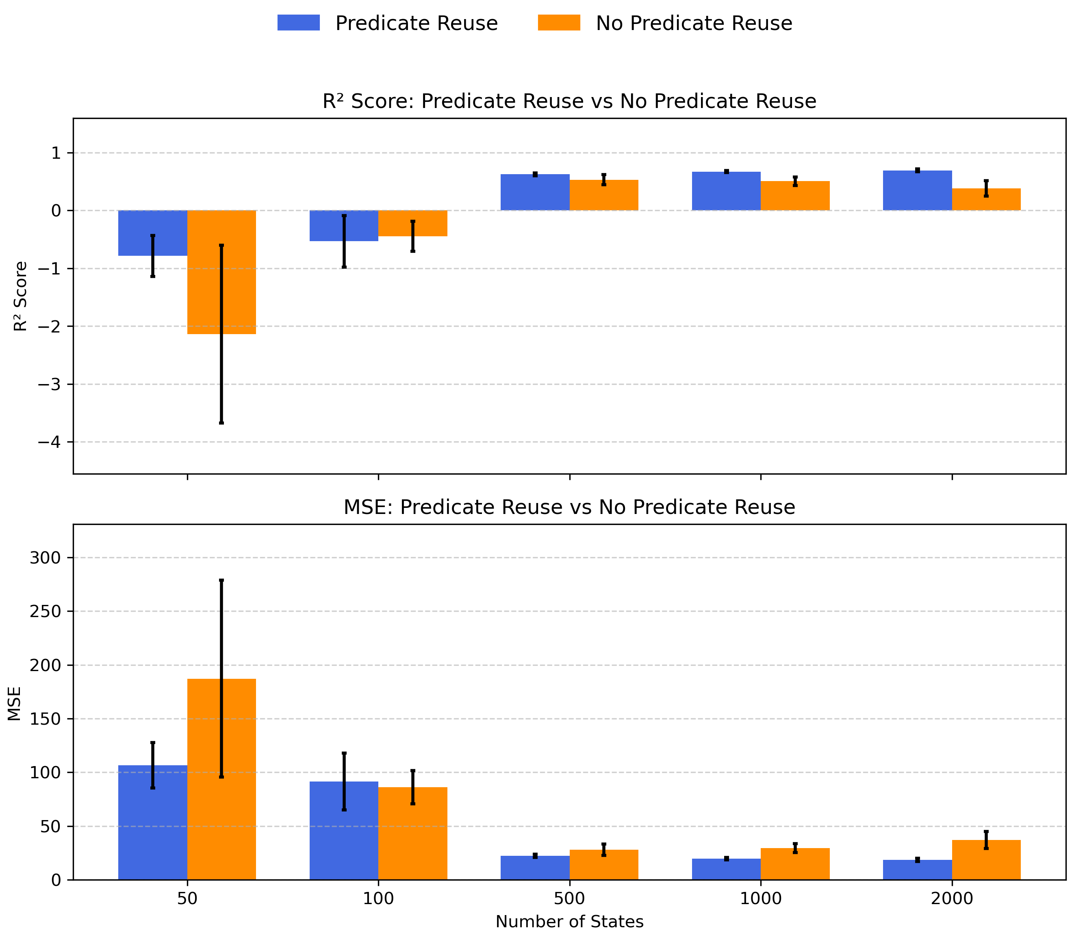
PERFORMANCE WITH AND WITHOUT PREDICATE REUSE
We can see increasing the sample size during training improves test accuracy in terms of R² score and Mean Squared Error (MSE).
Predicate reuse performs consistently better for heuristics learned with state sizes >=500.
Figure: Test result on 942 test samples.

Slide 32
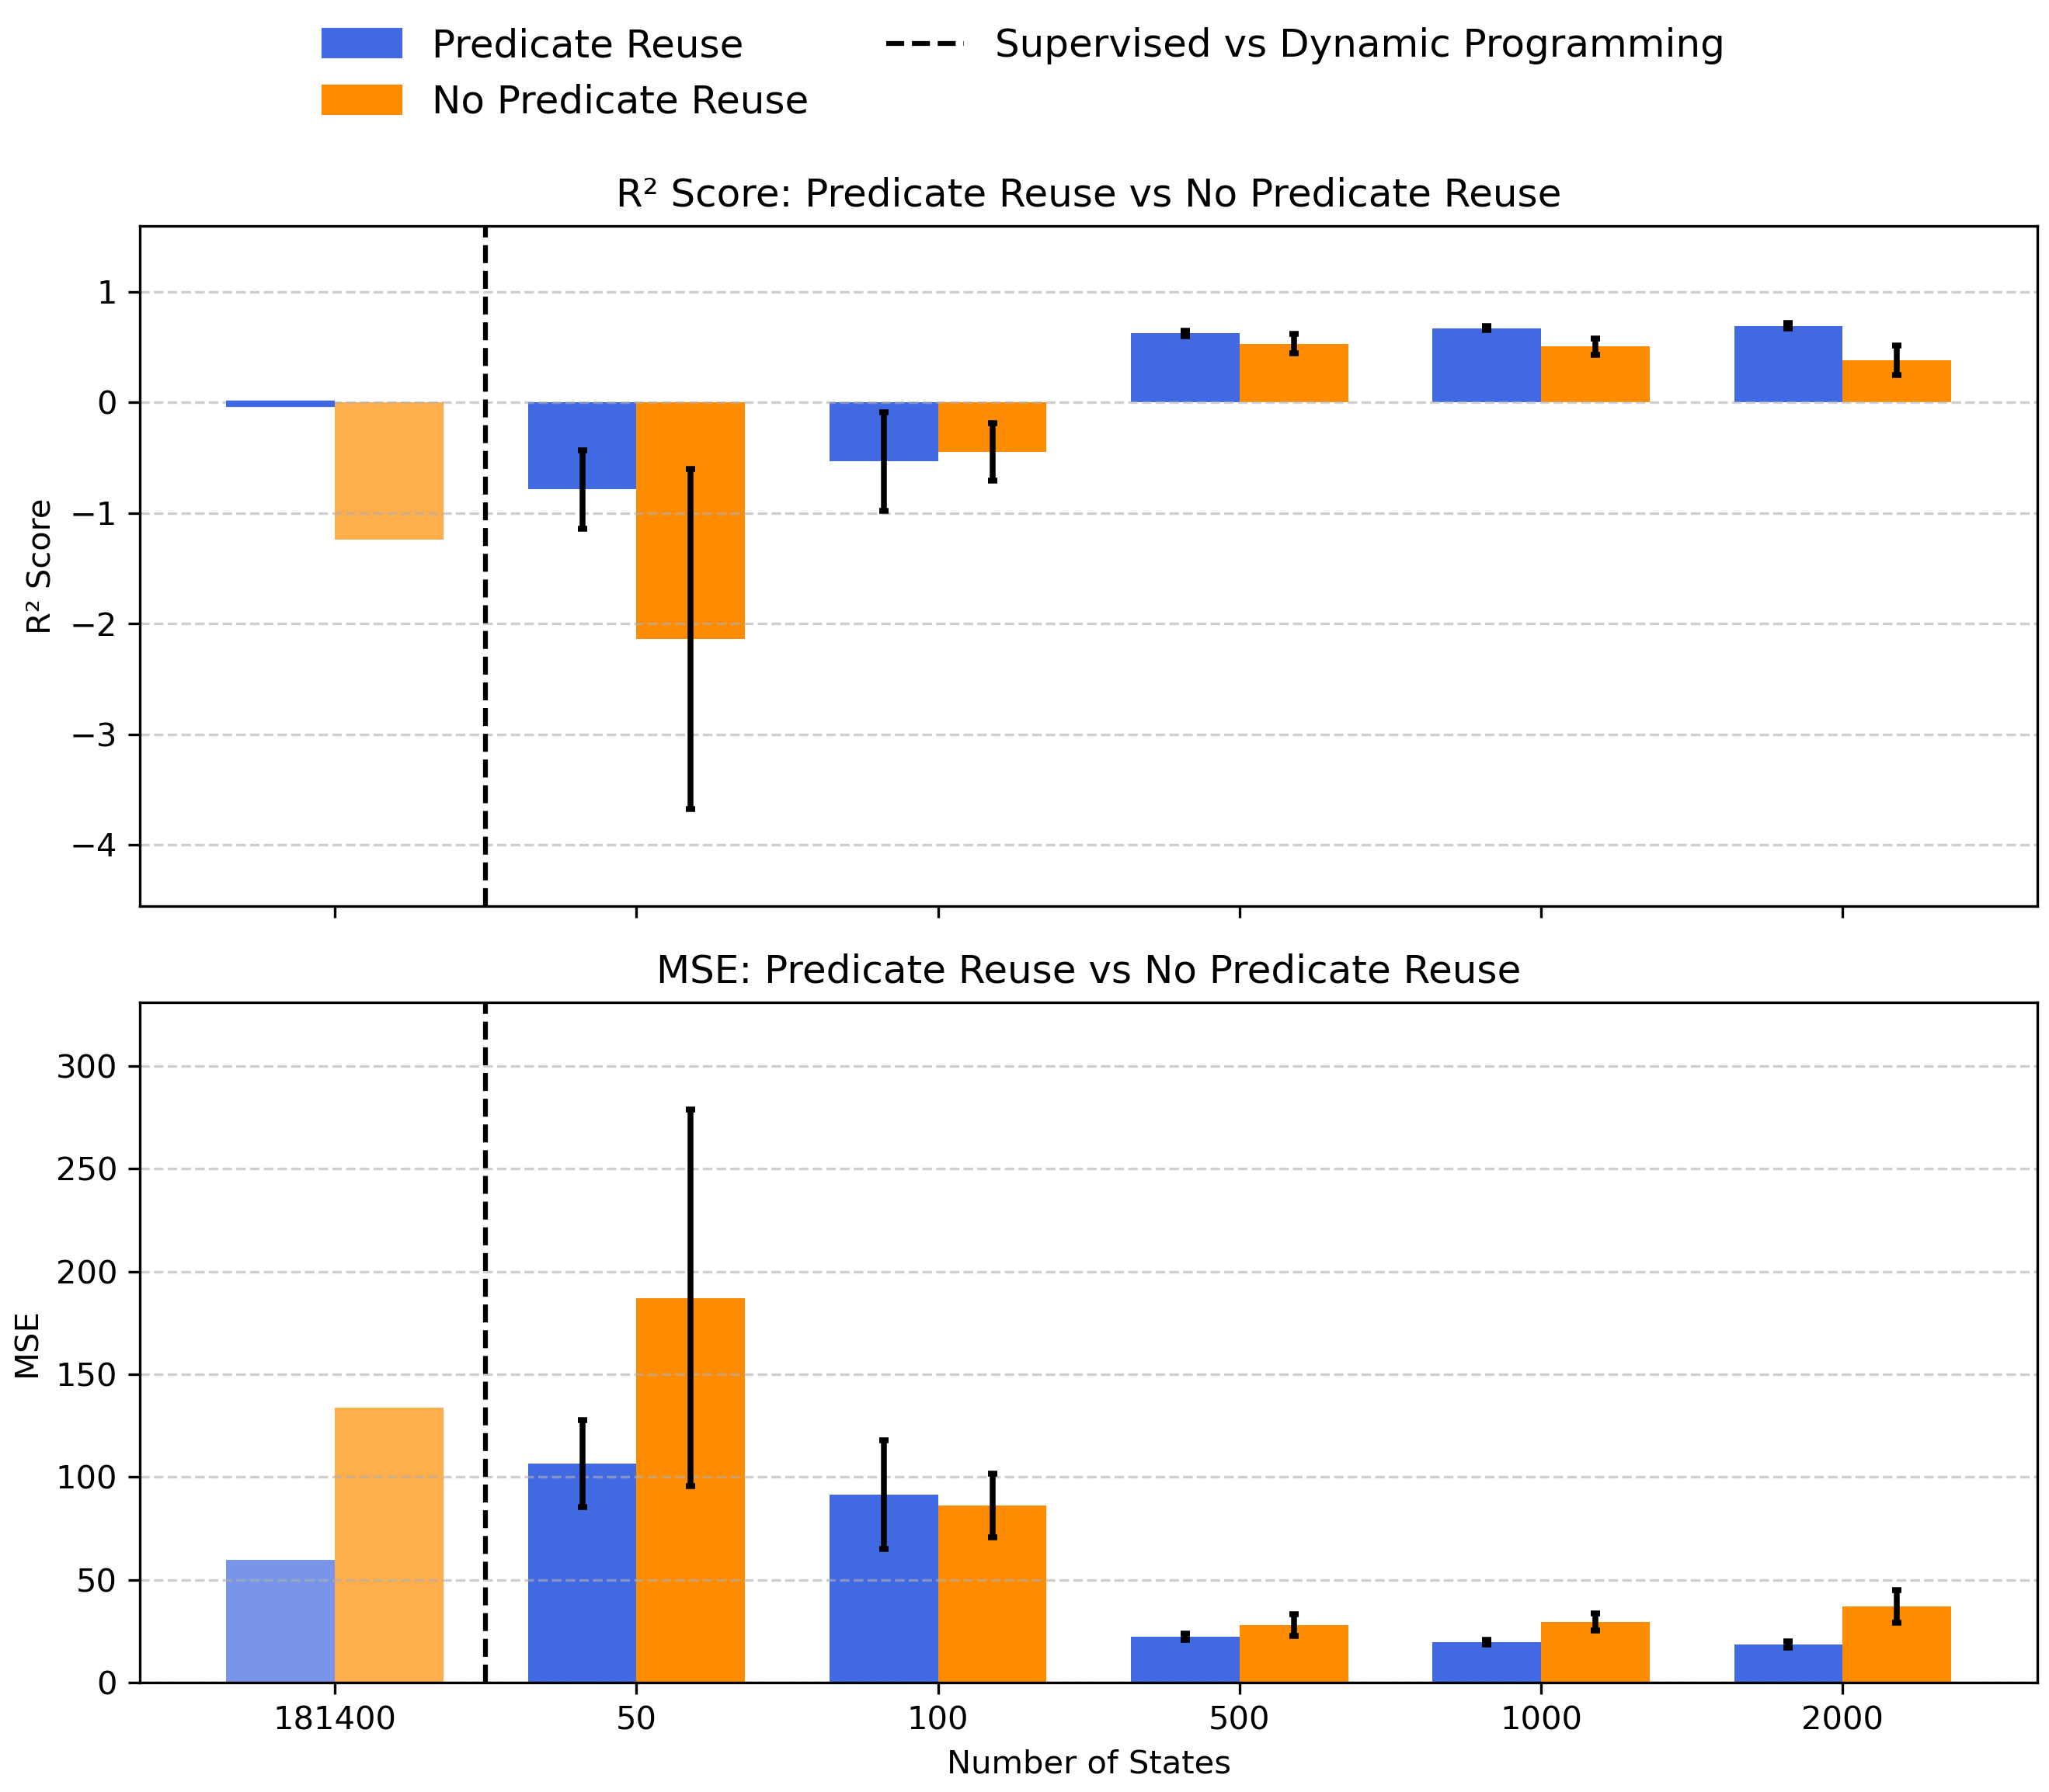
PERFORMANCE WITH AND WITHOUT SUPERVISED LEARNING
We observe the results with and without supervised learning.
We see that a heuristic function trained with all data does not perform as well as when we have a sample size of 1000 or 2000.
We have more training data, but according to these metrics, we do a poor job of estimating the cost-to-go. Why does this occur?
Figure: Test result on 942 test samples.

Slide 33
PERFORMANCE WITH AND WITHOUT SUPERVISED LEARNING
We observe the results with and without supervised learning.
We see that a heuristic function trained with all data does not perform as well as when we have a sample size of 1000 or 2000.
We have more training data, but according to these metrics, we do a poor job of estimating the cost-to-go. Why does this occur?
We believe this is because, since we are using the entire dataset, there are more negative examples and, therefore, Popper requires more time to find a hypothesis that does not entail any negative examples.
So, in case it cannot differentiate between positive and negative datasets, the results underestimate the heuristic value.
Figure: Test result on 942 test samples.

Slide 34
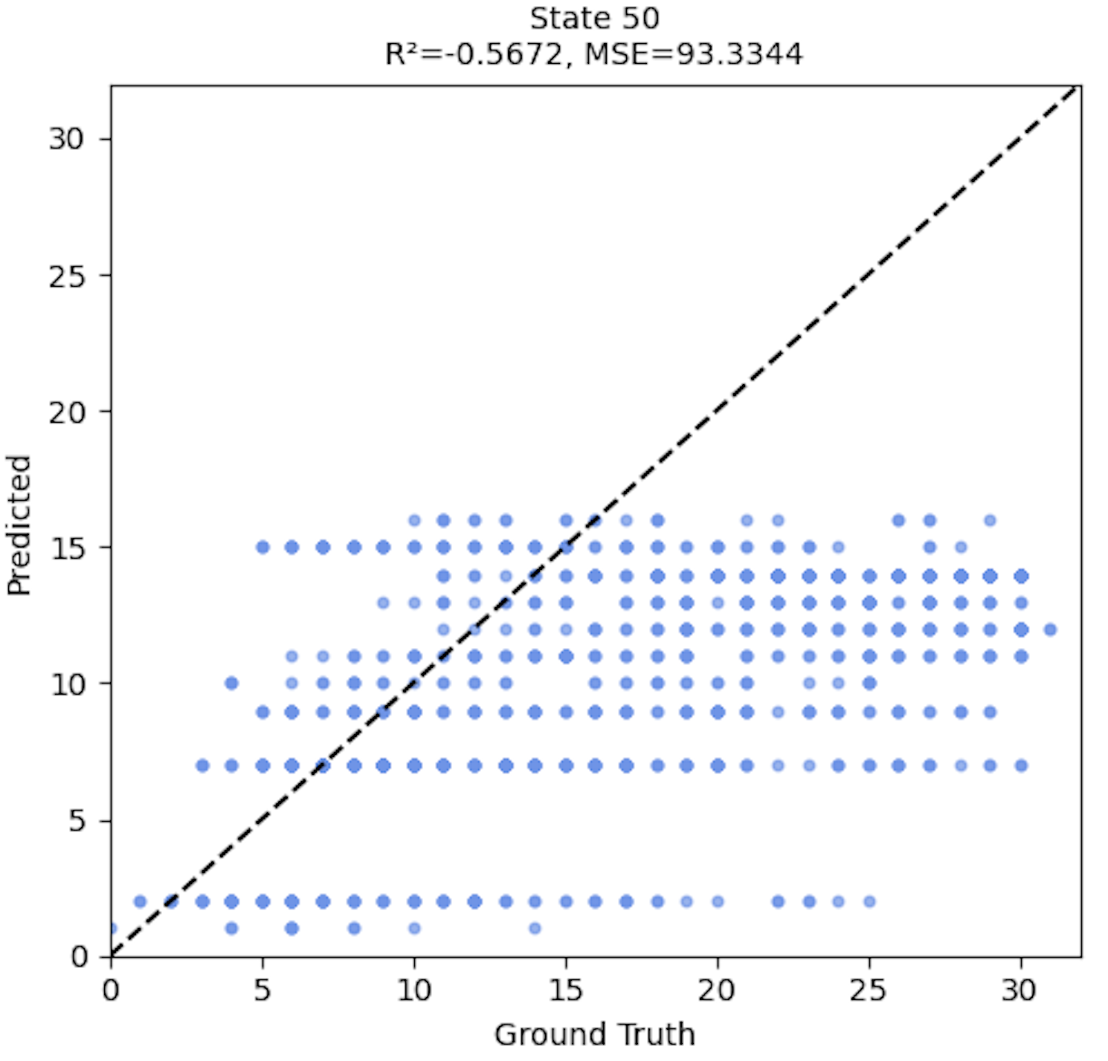
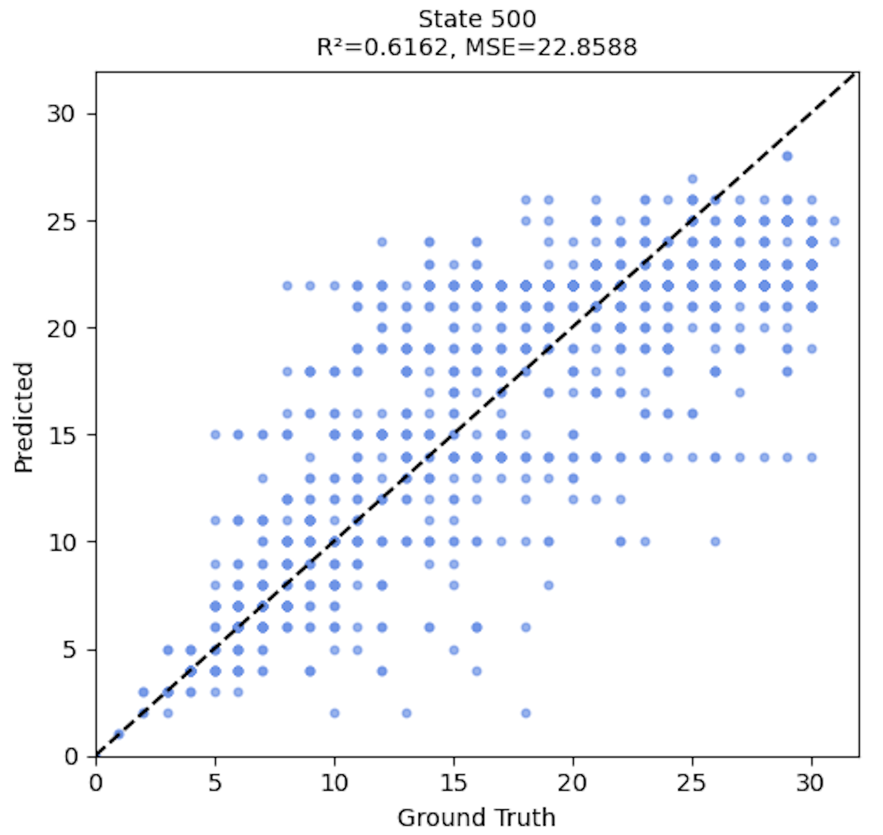
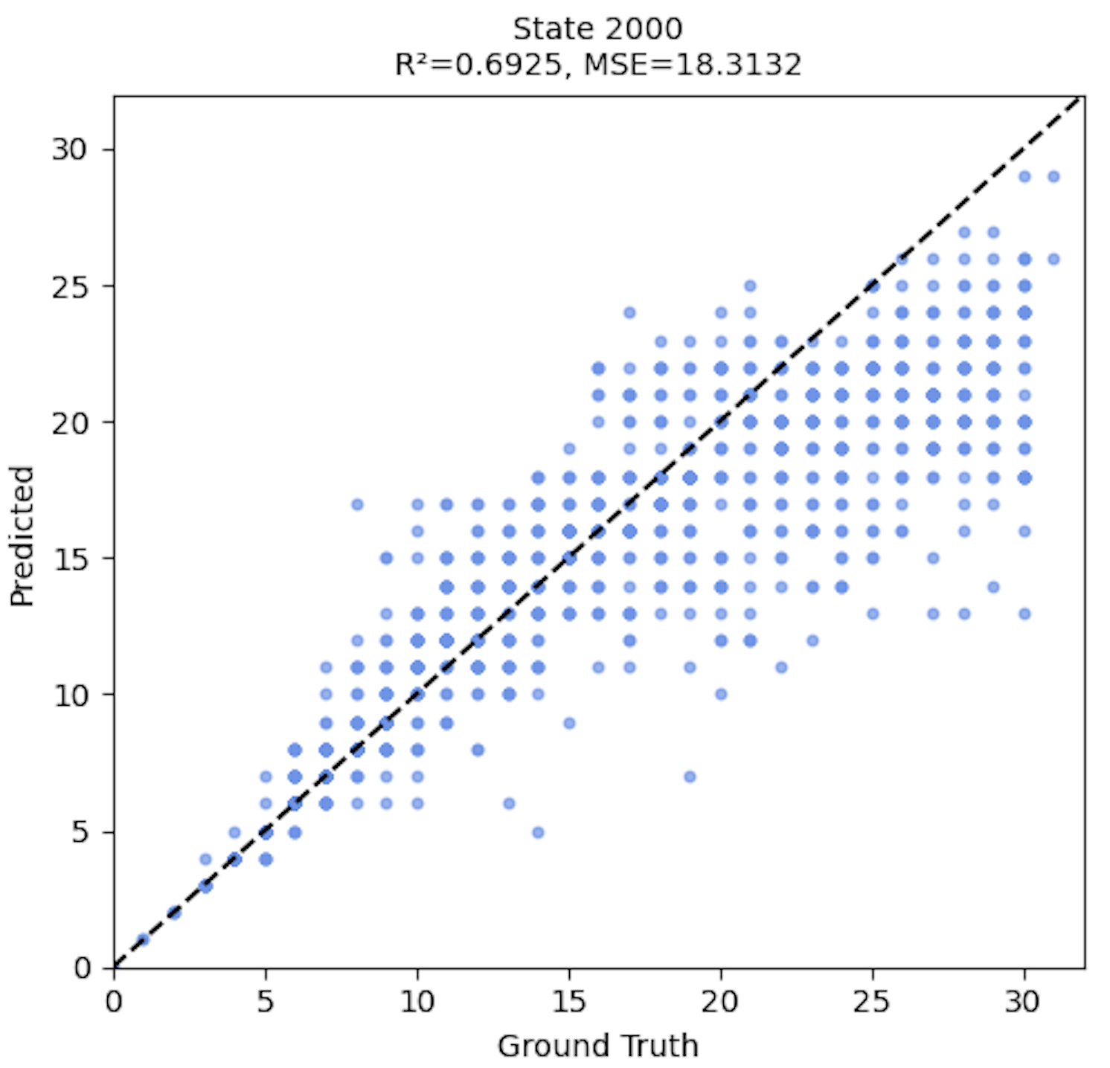
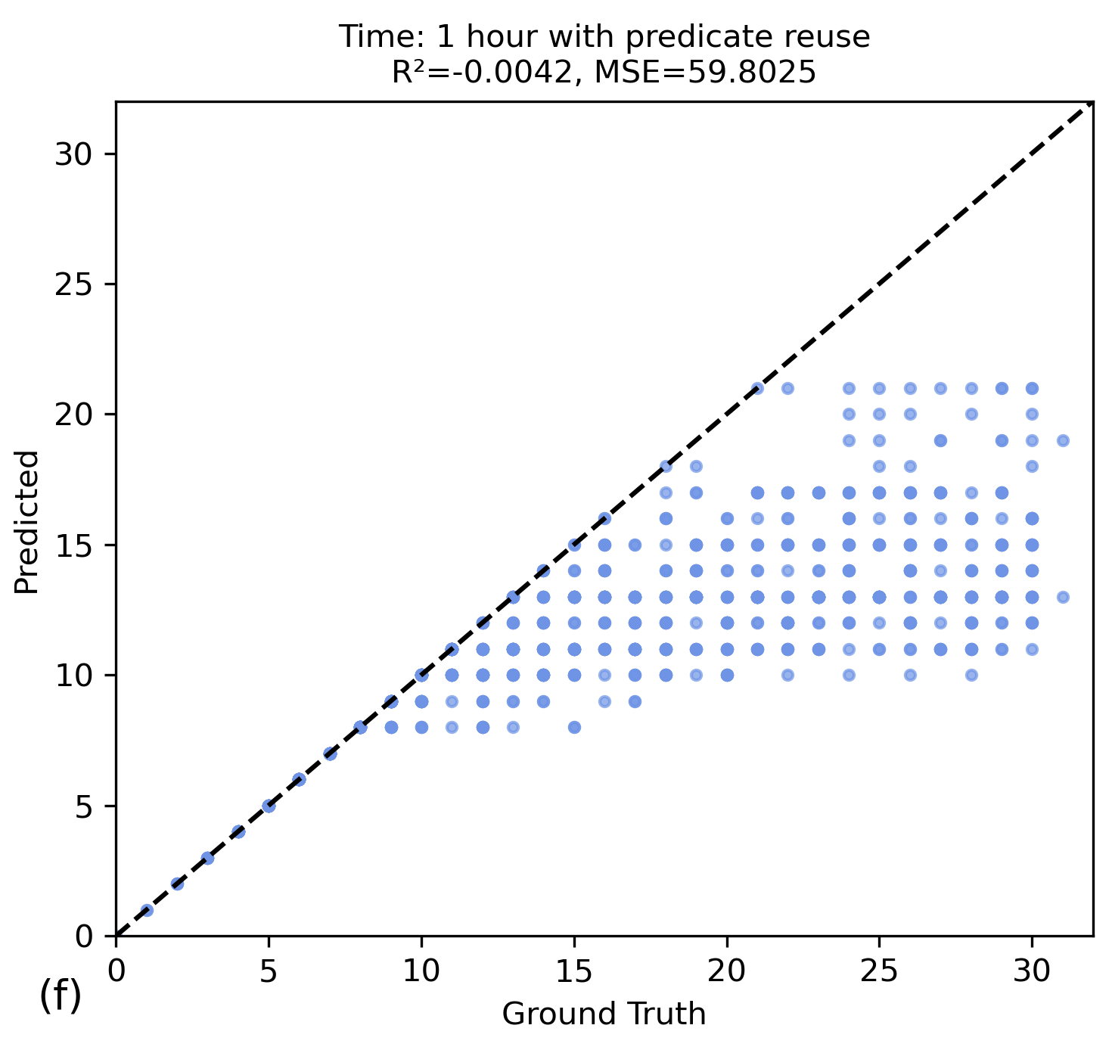
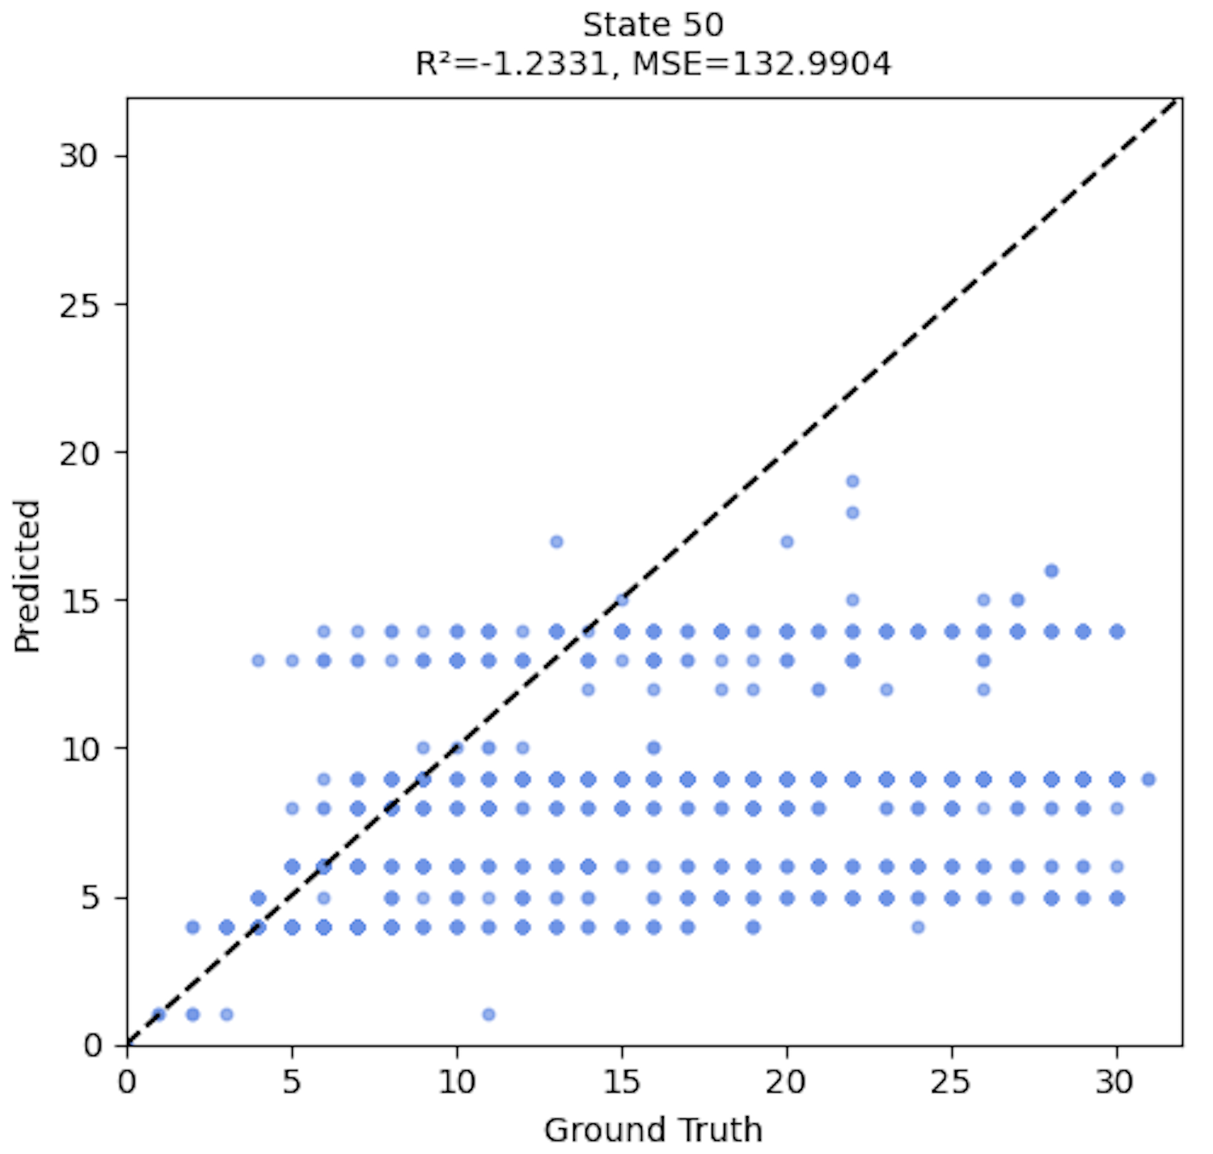
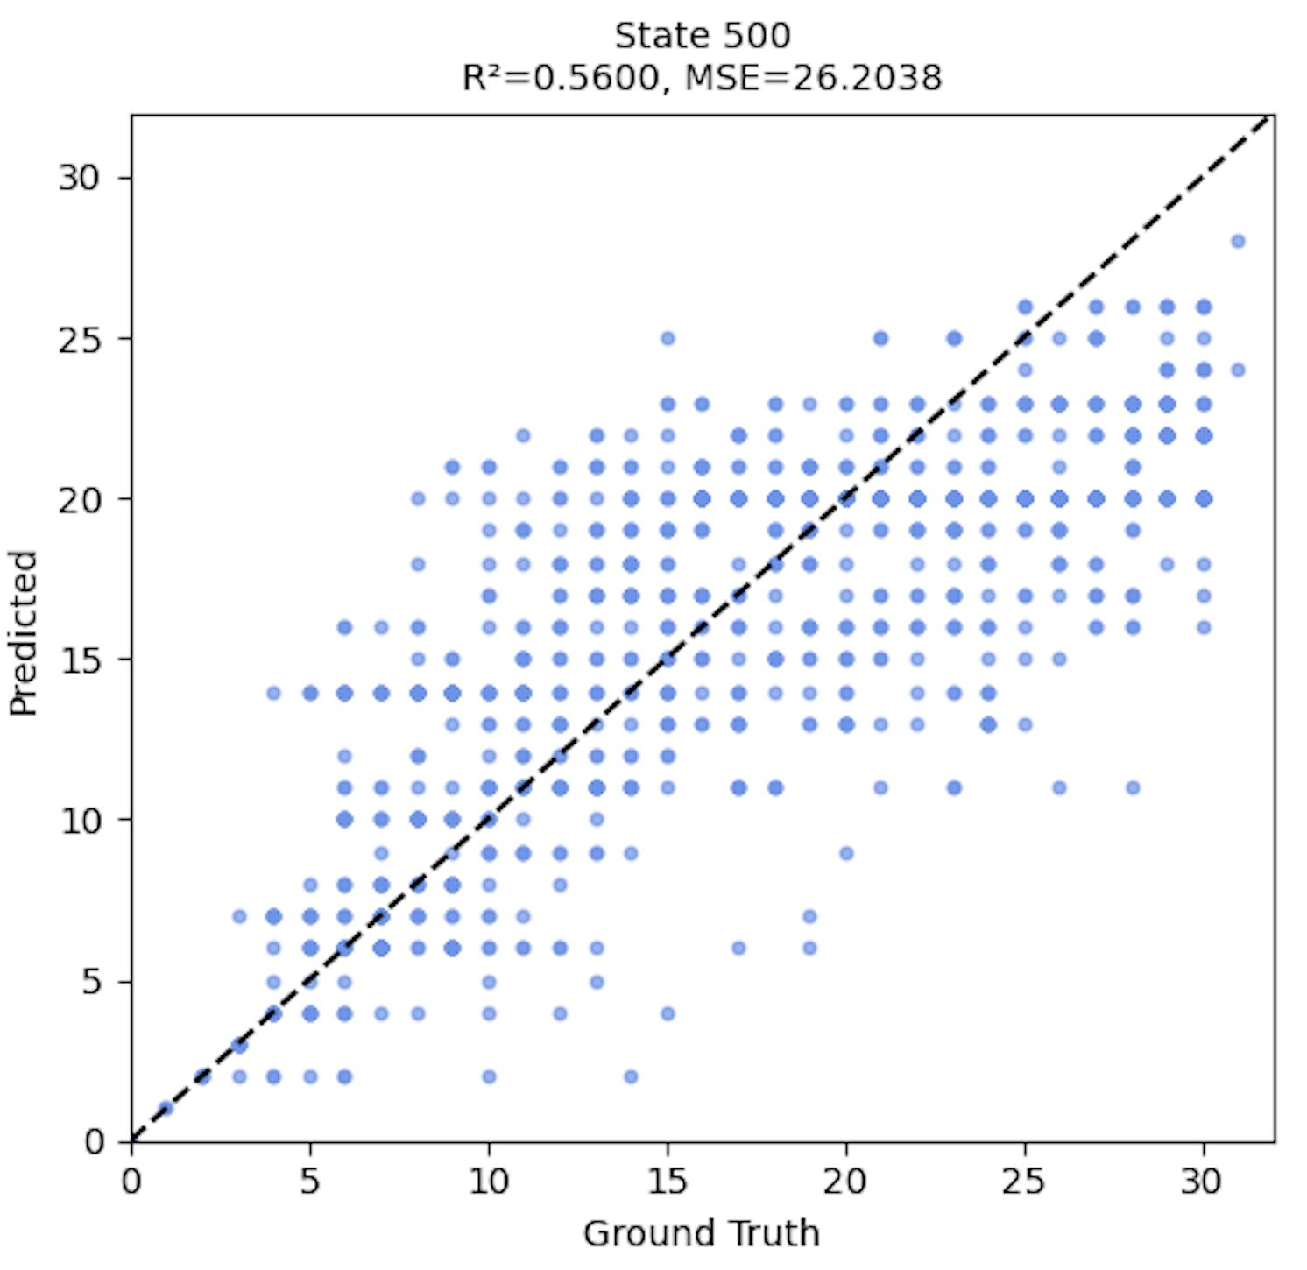
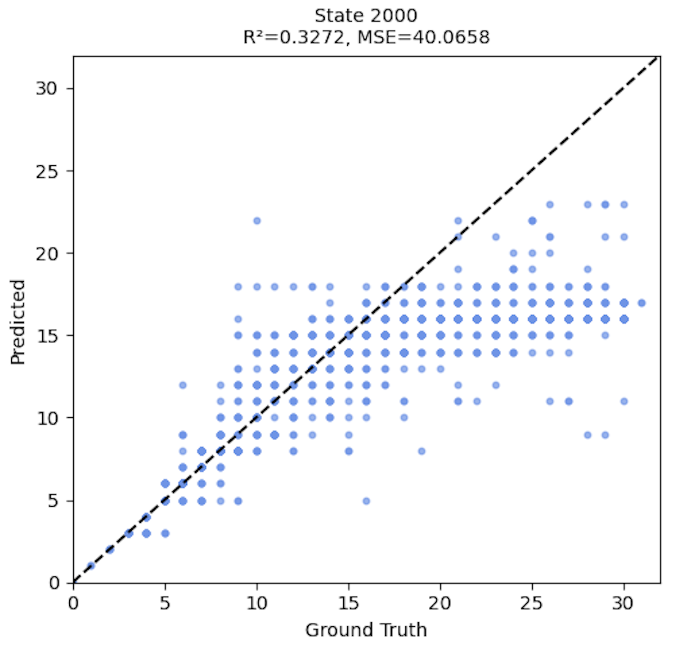
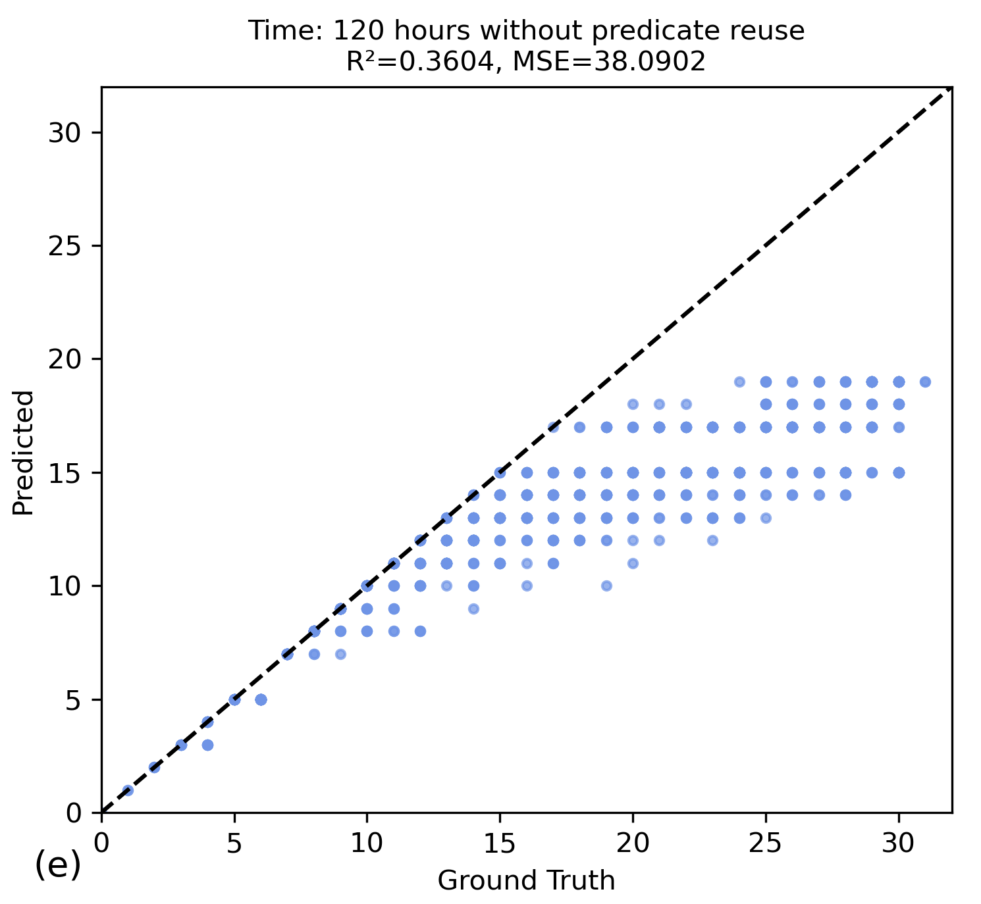
PERFORMANCE WITH AND WITHOUT PREDICATE REUSE
The conservative estimate can be shown in these plots.
We can see initially, around state size 500, it starts to align with the higher cost-to-go.
In case of without predicate reuse it gets more conservative from 500 to 2000.
We can also see that it gives us more expressibility with predicate reuse. So, it does not have to be as conservative as no predicate reuse.
Even if not all of them are matched, it can match more of them.
MEDIAN PLOT WITH PREDICATE REUSE
SUPERVISED LEARNING PLOT
WITH PREDICATE REUSE
MEDIAN PLOT WITHOUT PREDICATE REUSE
SUPERVISED LEARNING PLOT
WITHOUT PREDICATE REUSE

Slide 35
PERFORMANCE WITH AND WITHOUT PREDICATE REUSE
The conservative estimate can be shown in these plots.
We can see initially, around state size 500, it starts to align with the higher cost-to-go.
In case of without predicate reuse it gets more conservative from 500 to 2000.
We can also see that it gives us more expressibility with predicate reuse. So, it does not have to be as conservative as no predicate reuse.
Even if not all of them are matched, it can match more of them.
MEDIAN PLOT WITH PREDICATE REUSE
SUPERVISED LEARNING PLOT
WITH PREDICATE REUSE
MEDIAN PLOT WITHOUT PREDICATE REUSE
SUPERVISED LEARNING PLOT
WITHOUT PREDICATE REUSE

Slide 36
PERFORMANCE WITH AND WITHOUT PREDICATE REUSE
When we do not have predicate reuse, there is more underestimation.
Even if not all of them are matched, it can match more of them.
When we have more data up to a certain point, there is less underestimation, but then after a certain point, there is more because we have more negative examples.
MEDIAN PLOT WITH PREDICATE REUSE
SUPERVISED LEARNING PLOT
WITH PREDICATE REUSE
Lack of expressive power causes underestimation.
MEDIAN PLOT WITHOUT PREDICATE REUSE
SUPERVISED LEARNING PLOT
WITHOUT PREDICATE REUSE

Slide 37
PERFORMANCE WITH AND WITHOUT PREDICATE REUSE
When we do not have predicate reuse there is more underestimation.
Even if not all of them are matched, it can match more of them.
When we have more data up to a certain point there is less underestimation but then after a certain point there is more because we have more negative examples.
MEDIAN PLOT WITH PREDICATE REUSE
SUPERVISED LEARNING PLOT
WITH PREDICATE REUSE
MEDIAN PLOT WITHOUT PREDICATE REUSE
SUPERVISED LEARNING PLOT
WITHOUT PREDICATE REUSE

Slide 38
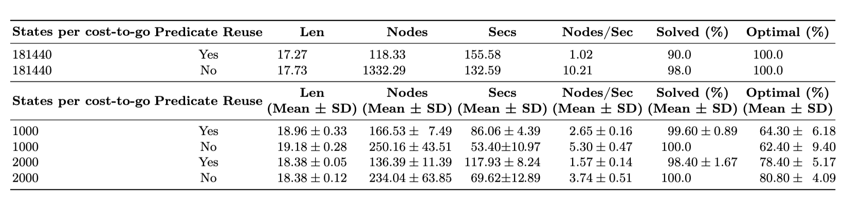
PERFORMANCE WITH AND WITHOUT PREDICATE REUSE
Heuristic search with the learned heuristic function for 50 test samples.
We can solve problems with a learned heuristic function.
For this, we are doing A* search.
We use our learned heuristic function as a heuristic for A* search.
Metrics reported include the average path length, the number of expanded nodes, solve time in seconds, search speed, the percentage of problems solved, and optimally solved problems.

Slide 39
PERFORMANCE WITH AND WITHOUT PREDICATE REUSE
Heuristic search with the learned heuristic function for 50 test samples.
Even though no predicate reuse solves more states, it has to explore more nodes than with predicate reuse; about 10 times more nodes are expanded for supervised learning.
It informs us that heuristic learned with predicate reuse is more informative than one learned without predicate reuse.
So, as the problem gets harder, the heuristic learned without predicate reuse will not scale.

Slide 40
PERFORMANCE WITH AND WITHOUT PREDICATE REUSE
Heuristic search with the learned heuristic function for 50 test samples.
A similar trend can be seen with dynamic programming search with predicate reuse.
However, it is not as severe.
The number of node expansions is about two times that of the one with predicate reuse..

Slide 41
PERFORMANCE WITH AND WITHOUT PREDICATE REUSE
Heuristic search with the learned heuristic function for 50 test samples.
We can see that Nodes/Sec without predicate reuse is higher than that of predicate reuse.
This can be solved using parallelization analogous to using GPUs for DNN.

Slide 42
OUTLINE
Background
Motivation
Problem Statement
Mapping states to numbers
Learning Logic Program Heuristics for Supervised Dataset
Generating Dataset
Learning Logic Program Heuristics for Supervised Datasets with Predicate Reuse
Logic Program Heuristics With Dynamic Programming Search
Generating Dataset with A* Search
Learning Heuristics Without Predicate Reuse
Learning Heuristics With Predicate Reuse
Performance Evaluation
Explainability
Takehome

Slide 43
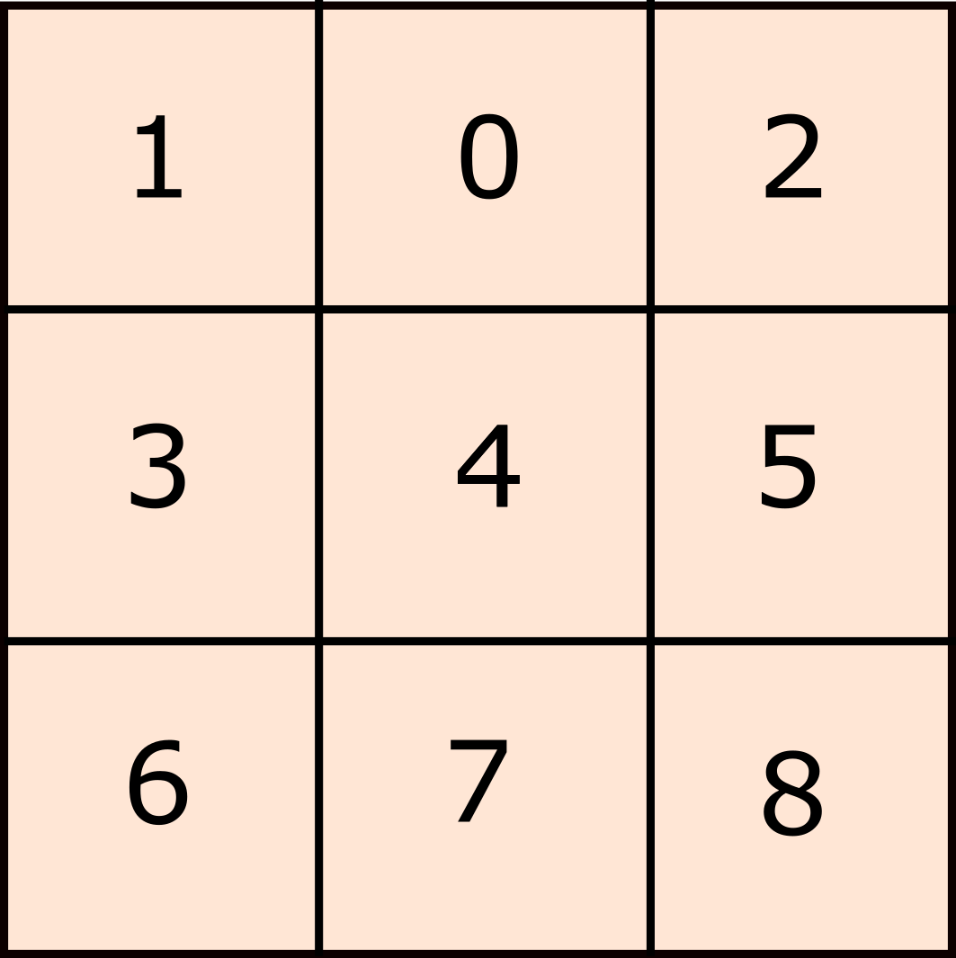
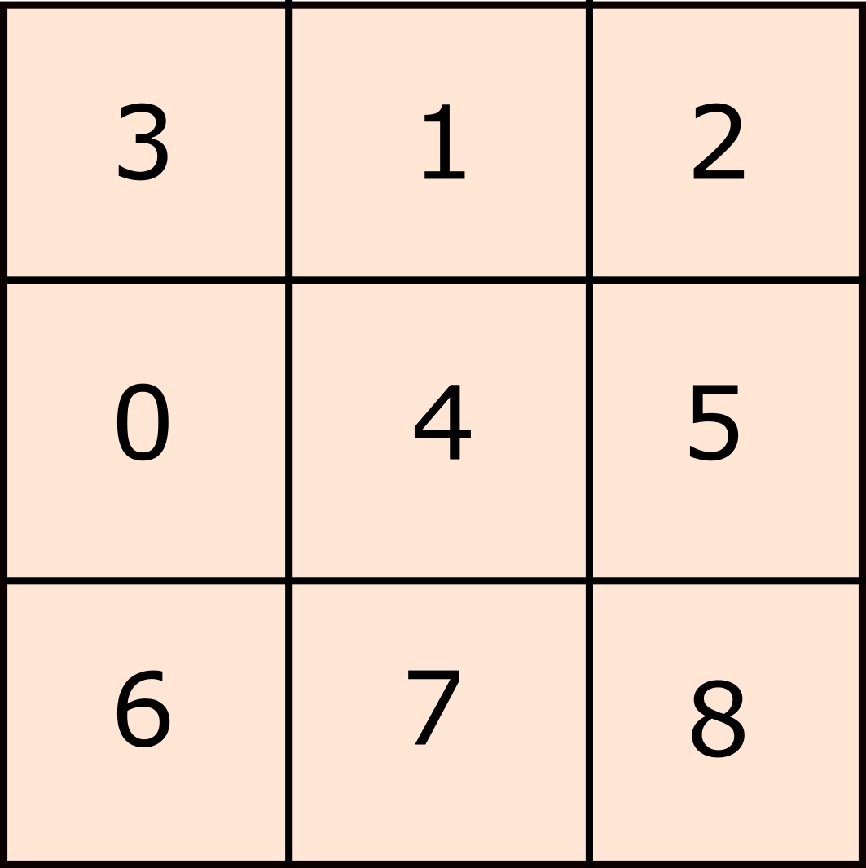
Example: LEARNED PREDICATES
That is an instance of learning about a domain from logic program as heuristics.
This is a learned rule for the cost-to-go of at least 2.
{tile(V2),after_tile(V2,V3),not_inplace_clause(V0,V3), goal_index(V3,V4),indx4(V1), distinct_indices(V4,V1)’]}
Distance = 1 case
We can only solve in one move by swapping the blank at idx1 with:
t1 (at idx2) → state [t1,b,t2,t3,...]
t3 (at idx4) → state [t3,t1,t2,b,...]
For that, either t1 is misplaced or t3 is misplaced.
Pick some tile (t1..t8). Pick its successor. V3 can be any tile from t2 to t8. Any tile from t2 to t8 could be misplaced. Get V3's correct goal index. However, V3 goal index cannot be index 4.
Note: tiles are named form t0….t8 from blank to 8
indices are named from idx1…..idx9

Slide 44
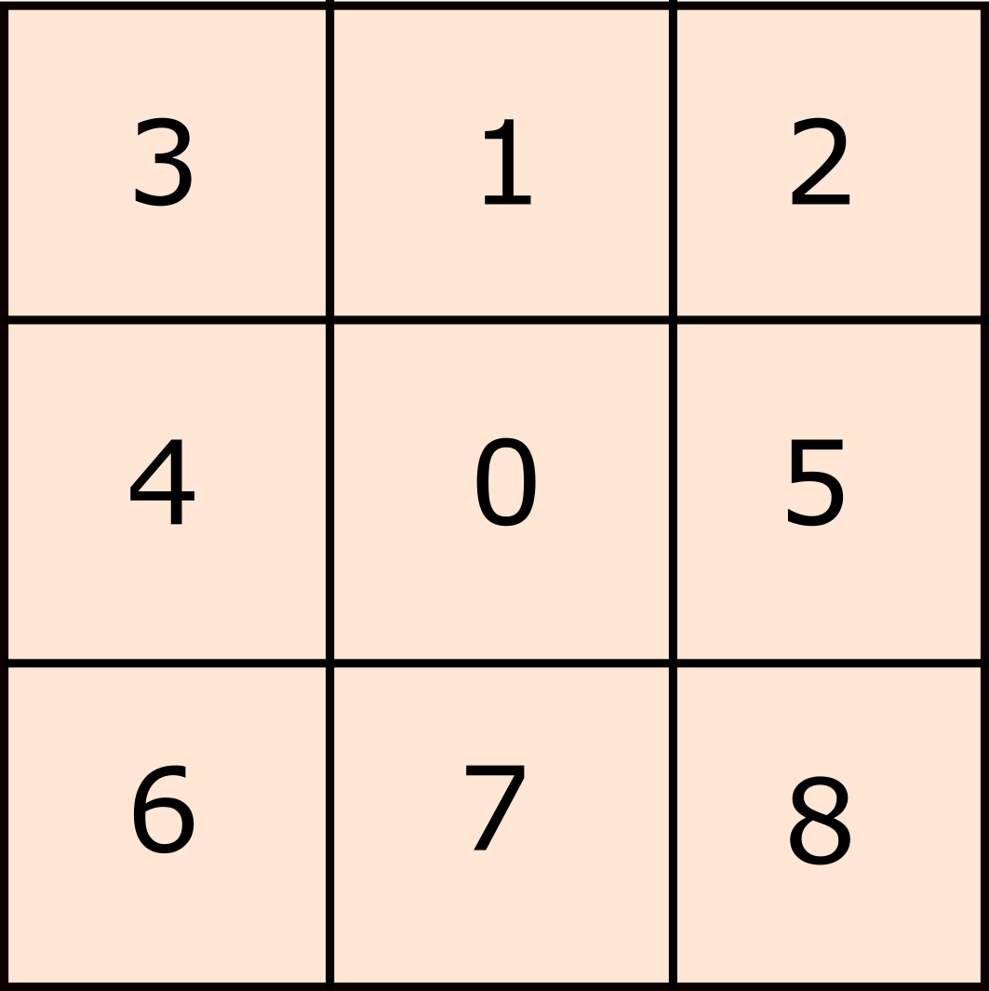
Example: LEARNED PREDICATES
{tile(V2),after_tile(V2,V3),not_inplace_clause(V0,V3), goal_index(V3,V4),indx4(V1), distinct_indices(V4,V1)’]}
“There exists a successor tile V3 (one of t2..t8) such that, in state V0, V3 is out of place, and V3’s correct goal position is not idx4.”
What states does it match:
Any state where some tile among {t2, t4, t5, t6, t7, t8} is misplaced (i.e., not at its goal), since those all have goal indices ≠ idx4. It will enumerate all positions for that tile except its goal position.
Since we can understand our heuristics more easily than a Deep Neural Network, this opens a new avenue for explainable pathfinding.

Slide 45
TAKEHOME
We can learn heuristic functions with Inductive Logic Programming without existing labels or supervised data.
We see that the predicate reuse can significantly improve our ability to estimate true cost-to-go.
We Introduced a novel algorithm to learn heuristic functions as logic programs in a domain-independent manner.
We demonstrated effectiveness on the 8-puzzle domain.
Opened new directions for explainable pathfinding.

Slide 46
CHALLENGES AND FUTURE WORK
We observed that the supervised learning case had lower accuracy due to more negative examples.
Use ILP methods that allow misclassifications.
We observed that predicate reuse slows down computation time.
Compared to neural approaches, logic programs lack GPU-level parallelism, creating a performance gap for large-scale search.
Look for ways to speed up the application of logic programs by exploiting parallelism.
Scalability beyond the 8-puzzle to larger domains is untested.
Scale the approach to larger domains (15-puzzle, reaction synthesis).

Slide 47
References
https://cse.sc.edu/~foresta/assets/files/SoCSMasterClass.pdf. (Accessed, 2025)
Cropper, Andrew, and Rolf Morel. "Learning programs by learning from failures." Machine Learning 110.4 (2021): 801-856.
Agostinelli, Forest, et al. "Solving the Rubik’s cube with deep reinforcement learning and search." Nature Machine Intelligence 1.8 (2019): 356-363.
Hocquette, Céline, et al. "Learning MDL logic programs from noisy data." Proceedings of the AAAI Conference on Artificial Intelligence. Vol. 38. No. 9. 2024.

Slide 48

THANK YOU!
Name: Rojina Panta
Title: PhD Student
Email: rpanta@email.sc.edu

